Slide 1
Annual Business Meeting/ Annual Report

Slide 2
Welcome!
Reflections
Introductions

Slide 3
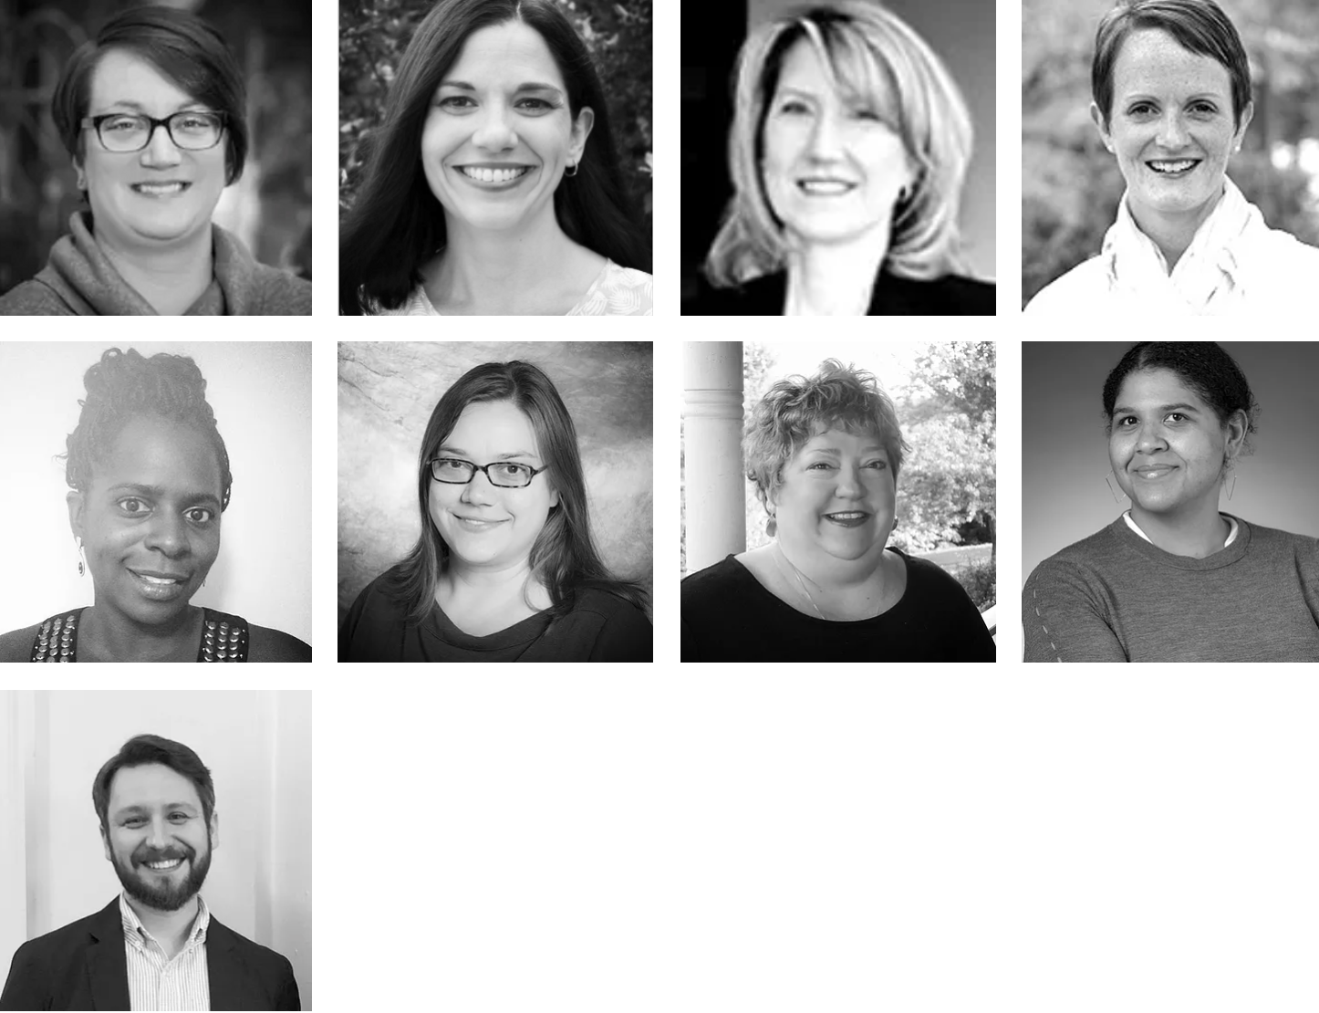
Amanda Quesenberry, President
Darla Gundler, President-Elect
Megan Purcell, Vice-President
Megan Vinh, Past-President
LaShorage Shaffer,
Secretary
Jessica Hardy,
Treasurer
Cori Hill, Member-at-Large
Krista Scott, Member-at-Large
DEC Executive Board
https://www.dec-sped.org/executive-board
Justin Lane, Member-at-Large

Slide 4
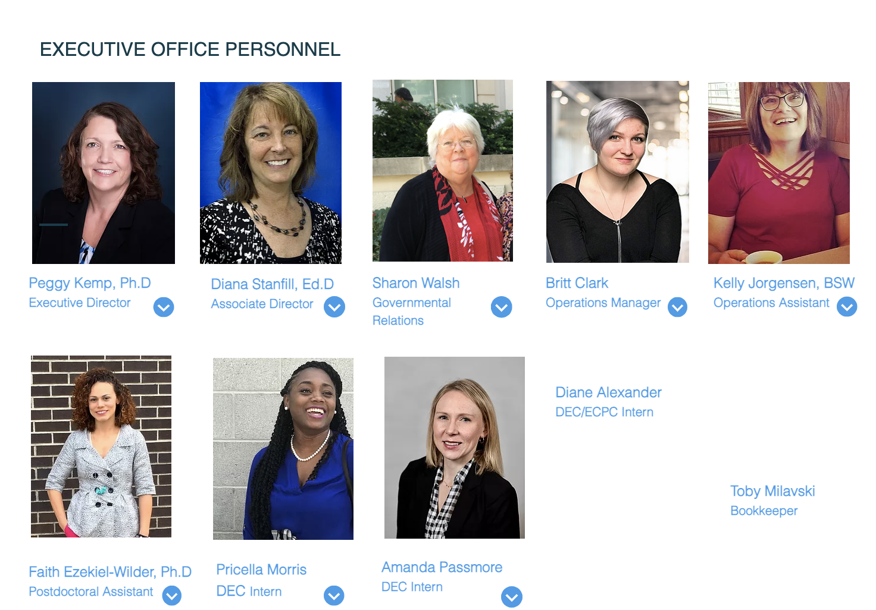

Slide 5
Approval of 2019 Minutes
Minutes approved via electronic vote sent out to the attendees.

Slide 6
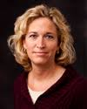
Recognition of Retired Board Members
Ted Burke
Chelsea Guillen

Slide 7
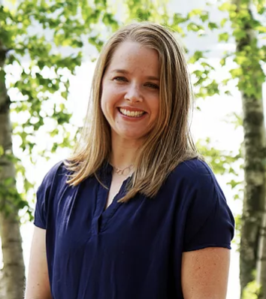
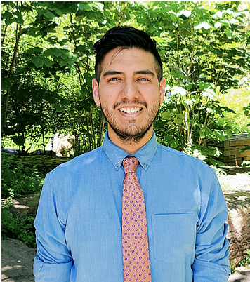
Introduction of New EB Members - 07/01/21
Jenna Weglarz-Ward
Incoming Vice President
Victor James-Young
Member-at-Large

Slide 8
DEC Leaders in CEC!
IDC - Ted Burke ( DEC Past President) – co-chair
PROJECT 2020 – Megan Vinh, Megan Purcell, Justin Lane (Current Board members)
CEC Policy Steering Committee -
Amanda Schwartz (PAC Committee, Policy Strand Lead)
Nate Marsden (PAC Committee)

Slide 9
2020 DEC Award Winners
Congratulations to the following DEC Award Winners
Lori Arndt - The Rose C. Engel Award for Excellence in Professional Practice
Carol Trivette - The Mary McEvoy Service to the Field Award
Maria Hugh - The J. David Sexton Doctoral Student Award
Sarah Tozer - The Kathleen W. McCartan Award
Serra Acar - The Merle B. Karnes Award for Service to the Division for Early Childhood
Ann Bingham and Laurie Dinnebeil - The DEC Award for Mentoring

Slide 10
Highlights from the Annual Report from the Executive Board and Executive Office for 2019-2020

Slide 11
Volunteers are the fuel that power associations. DEC offers a variety of ways for our members to get involved, from short-term volunteer projects to committee, COP, and board service. With every new volunteer, DEC grows more energized, more diverse and inclusive, and better equipped to reach our common goals.
THANK YOU!
THANK YOU!
THANK YOU!
THANK YOU!
THANK YOU!
THANK YOU!
THANK YOU!

Slide 12
Standards
The Initial Practice-Based Professional Preparation Standards for Early Interventionists/Early Childhood Special Educators (EI/ECSE)
The Initial Practice-Based Professional Preparation Standards for Early Interventionists/Early Childhood Special Educators (EI/ECSE) were approved by the CEC Board in July 2020.
NEW RESOURCES!!
https://www.dec-sped.org/ei-ecse-standards

Slide 13
Partnerships
ZTT
Early Childhood Personnel Center
Early Childhood Technical Assistance Center

Slide 14
Partnerships
ZTT
NCPMI
STEMIE
NAEYC
ZTT

Slide 15
Partnerships
ECPC
ECTA
P2P
NAEYC
ZTT

Slide 17
New DEC Committees!
Research Committee – 2020
Coming Soon: DEC Program Review Committee
Notes:
Call for New DEC Committee: DEC Program Review Committee
DEC is establishing a new committee whose responsibility will be to support, monitor, and provide guidance to the CEC/DEC program review and recognition process.
What is the DEC Program Review Committee?
DEC recently developed the first set of stand-alone standards for the preparation of Early Intervention and Early Special Education professionals. These standards have been approved by the CEC Board of Directors and by the Council for Accreditation of Educator Preparation (CAEP) for use in the CEC/CAEP program review process.
Beginning in Spring 2022, all EI/ECSE programs going through the CEC/CAEP program review process will be required to use the new EI/ECSE standards. Prior to Spring 2022, programs can choose to use the new standards but are not required to do so.
CEC has partnered with NCATE and CAEP for more than 25 years to review special education teacher preparation programs as part of the accreditation process. This process required EI/ECSE programs to demonstrate that they met the CEC Standards as informed by the EI/ECSE Knowledge and Skills Specialty Set. With the approval of stand-alone EI/ECSE standards, programs will no longer be evaluated against the CEC Special Education Standards but now will be reviewed against the EI/ECSE Standards.
CEC has always been responsible for providing resources to programs going through the review process, training program reviewers, maintaining records, monitoring reviewers and auditing program recognition reports, etc. Now that there are EI/ECSE Standards, DEC will collaborate with CEC staff and volunteers to create EI/ECSE-specific resources and training for both programs and reviewers. DEC will also actively monitor and analyze the EI/ECSE program review process and reviewer decision-making.
Example activities to expect from the Program Review Committee:
Develop and/or evaluate resource materials for EI/ECSE programs seeking national recognition through the CEC review process. These could include sample assessments, sample syllabi, model program reports, on-line resources, etc.
Develop and/or evaluate initial and on-going training and resources for EI/ECSE program reviewers. These could include mock reports for training, ongoing modification of decision rubrics, on-line training materials, etc.
Participate, as needed, in training of programs and of program reviewers.
Annually monitor and analyze efficiency and accuracy of program reviews
Select program reviewers
Coordinate with CEC staff to ensure consistency across the program review process
Program Review Committee Composition
The DEC Program Review Committee consists of individuals who have demonstrated a strong commitment to personnel preparation over the years. The membership is made up of DEC is recruiting 5 members (at least 3 from IHE EI/ECSE training programs) for this committee. Members must be current members of CEC/DEC. Members volunteer their time and are not considered members of the DEC Executive Board.
Member Qualifications and Expectations
Must be a CEC/DEC member in good standing
Have a significant interest and/or experience in teacher preparation standards, assessment of teacher candidates, and/or the program review process
Attend and contribute to project work and conference calls/virtual meetings
Make the necessary time commitment (approximately 8-10 hours per month although this may be staggered across the year)

Slide 18
Call for YEC Editor – Released Feb 01, 2021

Slide 19
Policy
Notes:
Sharon Walsh- Governmental Relations Working Closely with CEC and

Slide 20
Policy
Special Education Legislative Summit
DEC Wrap Around!!
Sharon Walsh, DEC’s Governmental Relations
Kuna Tavalin, CEC’s Senior Policy and Advocacy Advisor
Funding Early Childhood is the Right IDEA Act H.R. 4107
Notes:
Register for the SELS here. DEC event registration will remain open but SELS Registration closes July 9th at 5 pm EST, so be sure to register soon!
If you are not currently a CEC member, your registration fee will be $100. Why not become a CEC member for $65 and go free? Better yet, become a CEC and DEC member for only $115 and have both the summit and one year of CEC and DEC for the price of $115 vs. $215! You can’t miss this deal! Plus – DEC is offering wrap around activities! FREE
Kickoff Event
Join us for the DEC Kickoff for SELS!
Friday, July 10th, 2020, 4:15 - 5:00 PM EST
Register here.
Week One Schedule
Washington Update – A Live Town Hall Event Monday, July 13th, 2020, 3:00 – 4:00 PM EST
This exciting event kicks off our Virtual SELS experience and provides a program overview of the week and your first set of tools when it comes to being an advocate. This event is included with SELS Registration.
Using Social Media Campaigns in Your State
Monday, July 13th, 2020, 4:15 - 5:00 PM EST
Join us for tips and techniques in designing and implementing your social media campaign. Register here.
Is it All About the Money? Federal Funding of Special Education Tuesday, July 14th, 2020, 3:00 - 4:00 PM EST In this overview of funding, you’ll learn not just how federal funding for special education works but also what are our “asks” in this area and what we may be expecting in this year’s appropriations. This event is included with SELS Registration.
DEC Open Mic Discussion on Legislation and Funding Tuesday, July 14th, 2020, 4:15 - 5:00 PM EST
Facilitated by DEC Policy and Advocacy Committee Members.
This is a time to ask your questions and share your thoughts about legislative and funding issues affecting early childhood. Register here.
Stemming the Tide: Addressing the Educator Shortages in Special Education Wednesday, July 15th, 2020, 3:00 - 4:00 PM EST Experts on this topic will share current information about educator shortage and the current status of the Higher Education Act, as well as what we will be asking for in this area during Virtual SELS. This event is included with SELS Registration.
DEC’s What’s Happening in Washington- An Early Childhood Update
Wednesday, July 15th, 2020, 4:15 - 5:00 PM EST
Presented by DEC’s Governmental Relations Consultant, Sharon Walsh. Register here.
Addressing the Mental Health Crisis in Our Schools Thursday, July 16th, 2020, 3:00 - 4:00 PM EST This session will provide an overview of not only the state of the mental health crisis, but also a glimpse into what educators may be facing as programs and schools reopen this fall. We will also cover what to ask for when meeting with your Congressional office. This event is included with SELS Registration.
DEC’s Open Mic Discussion on Shortages and Mental Health Thursday, July 16th, 2020, 4:15 - 5:00 PM EST
Facilitated by DEC Policy and Advocacy Committee Members.
This is a time to ask your questions and share your concerns about professional shortages and mental health issues in early childhood. Register here.
Special Education and the Pandemic
Friday, July 17th, 2020, 3:00 - 4:00 PM EST Speakers will address the current status of issues and funding related to COVID-19 and prepare you to address this topic during your virtual office visit. This event is included with SELS Registration.
DEC’s Planning for Next Week on the Hill
Friday, July 17th, 2020, 4:15 - 5:00 PM EST
Now it’s time to put our work into action and gear up for Week 2! Register here.
Week Two Schedule, July 20th - 24th
Week two will be dedicated to participants activating their advocacy skills to communicate with Members of Congress about our key issues through the means that suits each state’s delegation, i.e. through holding meetings with Members of Congress (either virtually, with their team in Washington, DC or by having a team of people visit their offices at home) and more. We will have ample social media cued up and coordinate a hashtag to amplify our message through social media both during the week and on an ongoing basis to carry our message forward.
DEC Debrief/Q&A Session
Monday, July 20th, 2020, 4:15 - 5:00 PM EST
DEC Policy and Advocacy Committee Members will be available to answer your questions and provide support as you work with in your state team. This will be a time to share what state teams are doing across the nation. Register here.
DEC Debrief/Q&A Session
Wednesday, July 22nd, 2020, 4:15 - 5:00 PM EST
DEC Policy and Advocacy Committee Members will be available to answer questions and provide support as you work with in your state team. This will be a time to share what state teams are doing across the nation. Register here.
DEC Next Steps: An Introduction to the Policy and Advocacy Community of Practice
Friday, July 24th, 2020, 4:15 - 5:00 PM EST
Join us as we celebrate our work over the past two weeks and make plans to keep the work going through a Community of Practice. Register here.

Slide 21
New Resources
Notes:
New (Free) Resources!!
PEAT'S SUITE Online: Self-Guided Module
Access this learning module for PEAT’s Suite to explore and practice using environmental features, as well as universal, modified and specialized assistive tools.
CARA's Kit Online: Self-Guided Module
Access this learning module to explore each topic of CARA’s Kit, from the introduction, to the process, to example adaptations.
We are excited to have these high quality resources find their home at DEC alongside the CONNECT Modules & Courses!
Each of these resources is designed to support the ECE/EI/ECSE workforce!
https://connectmodules.dec-sped.org/.../caras-kit-and.../
Thank you to our partners in this work: CONNECT Modules: ECPC, FPG
PEAT's Suite/CARA's KIT: Pennsylvania EI Technical Assistance, Pennsylvania Office of Child Development and Early Learning, Dr. Pip Campbell, and Dr. Suzanne Milbourne

Slide 22
New Resources
Notes:
New (Free) Resources!!
PEAT'S SUITE Online: Self-Guided Module
Access this learning module for PEAT’s Suite to explore and practice using environmental features, as well as universal, modified and specialized assistive tools.
CARA's Kit Online: Self-Guided Module
Access this learning module to explore each topic of CARA’s Kit, from the introduction, to the process, to example adaptations.
We are excited to have these high quality resources find their home at DEC alongside the CONNECT Modules & Courses!
Each of these resources is designed to support the ECE/EI/ECSE workforce!
https://connectmodules.dec-sped.org/.../caras-kit-and.../
Thank you to our partners in this work: CONNECT Modules: ECPC, FPG
PEAT's Suite/CARA's KIT: Pennsylvania EI Technical Assistance, Pennsylvania Office of Child Development and Early Learning, Dr. Pip Campbell, and Dr. Suzanne Milbourne

Slide 23
New Resources
Notes:
New (Free) Resources!!
PEAT'S SUITE Online: Self-Guided Module
Access this learning module for PEAT’s Suite to explore and practice using environmental features, as well as universal, modified and specialized assistive tools.
CARA's Kit Online: Self-Guided Module
Access this learning module to explore each topic of CARA’s Kit, from the introduction, to the process, to example adaptations.
We are excited to have these high quality resources find their home at DEC alongside the CONNECT Modules & Courses!
Each of these resources is designed to support the ECE/EI/ECSE workforce!
https://connectmodules.dec-sped.org/.../caras-kit-and.../
Thank you to our partners in this work: CONNECT Modules: ECPC, FPG
PEAT's Suite/CARA's KIT: Pennsylvania EI Technical Assistance, Pennsylvania Office of Child Development and Early Learning, Dr. Pip Campbell, and Dr. Suzanne Milbourne

Slide 24
We encourage you to deepen your engagement with DEC and your association peers. Volunteer today!
THANK YOU!
THANK YOU!
THANK YOU!
THANK YOU!
THANK YOU!
THANK YOU!
THANK YOU!

